Slide 1
CREDIT EDA CASE STUDY
By
Denis Roystan
&
Gagan Mathur

Slide 2
Categorical Univariate analysis for target 0

Slide 3
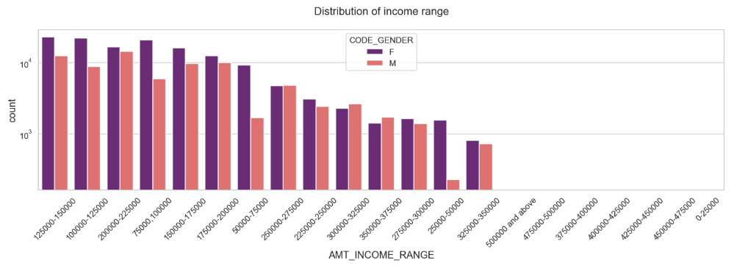
Distribution of Income range
Points to be concluded from the graph on the right side.
Female counts are higher than male.
Income range from 100000 to 200000 is having more number of credits.
This graph show that females are more than male in having credits for that range.
Very less count for income range 500000 and above.

Slide 4
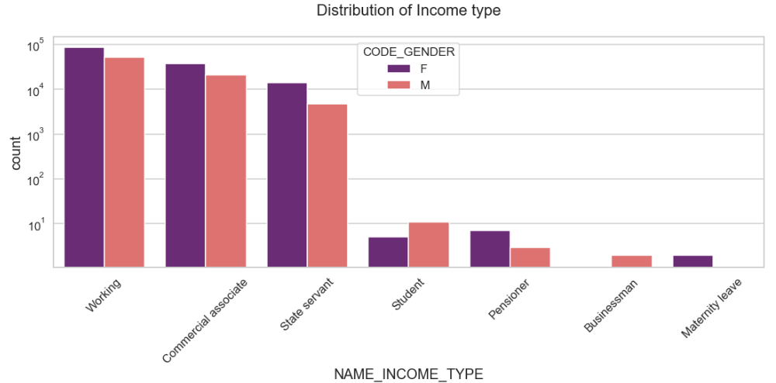
Distribution of income type
Points to be concluded from the graph on the right.
For income type ‘working’, ’commercial associate’, and ‘State Servant’ the number of credits are higher than others.
For this Females are having more number of credits than male.
Less number of credits for income type ‘student’ ,’pensioner’, ‘Businessman’ and ‘Maternity leave’.

Slide 5
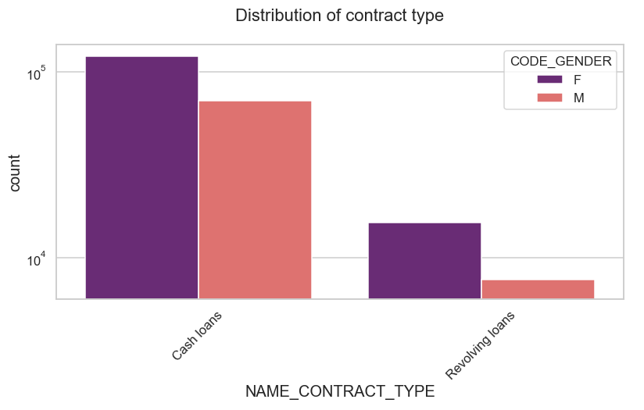
Distribution for contract type
Points to be concluded from the graph on the right.
For contract type ‘cash loans’ is having higher number of credits than ‘Revolving loans’ contract type.
For this also Female is leading for applying credits.

Slide 6
Categorical Univariate analysis for target 1

Slide 7
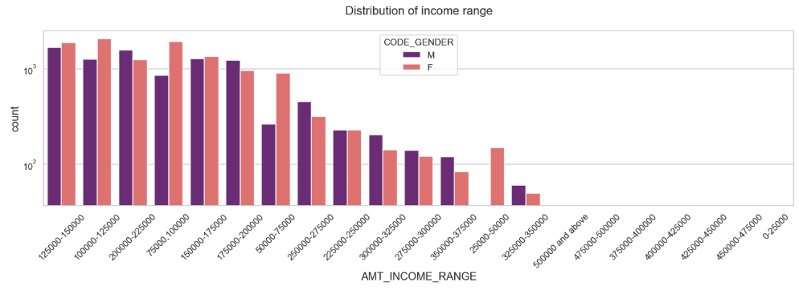
Distribution of Income range
Points to be concluded from the graph on the right side.
Male counts are higher than female.
Income range from 100000 to 200000 is having more number of credits.
This graph show that males are more than female in having credits for that range.
Very less count for income range 500000 and above.

Slide 8
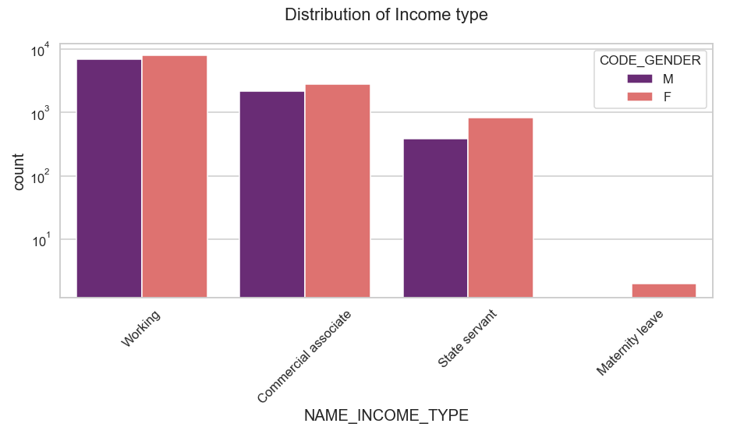
Distribution of income type
Points to be concluded from the graph on the right side.
For income type ‘working’, ’commercial associate’, and ‘State Servant’ the number of credits are higher than other i.e. ‘Maternity leave.
For this Females are having more number of credits than male.
Less number of credits for income type ‘Maternity leave’.
For type 1: There is no income type for ‘student’ , ’pensioner’ and ‘Businessman’ which means they don’t do any late payments.

Slide 9
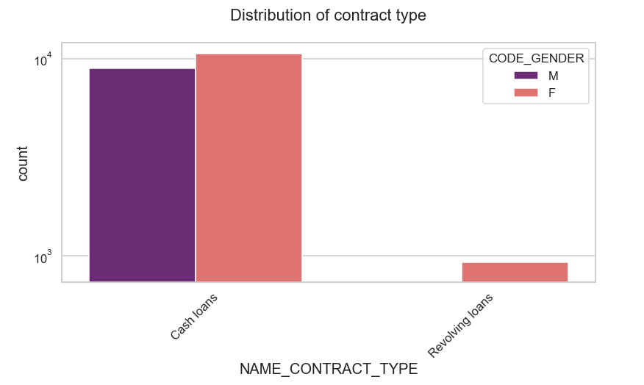
Distribution for contract type
Points to be concluded from the graph on the right.
For contract type ‘cash loans’ is having higher number of credits than ‘Revolving loans’ contract type.
For this also Female is leading for applying credits.
For type 1 : there is only Female Revolving loans.

Slide 10
Correlation of target 0

Slide 11
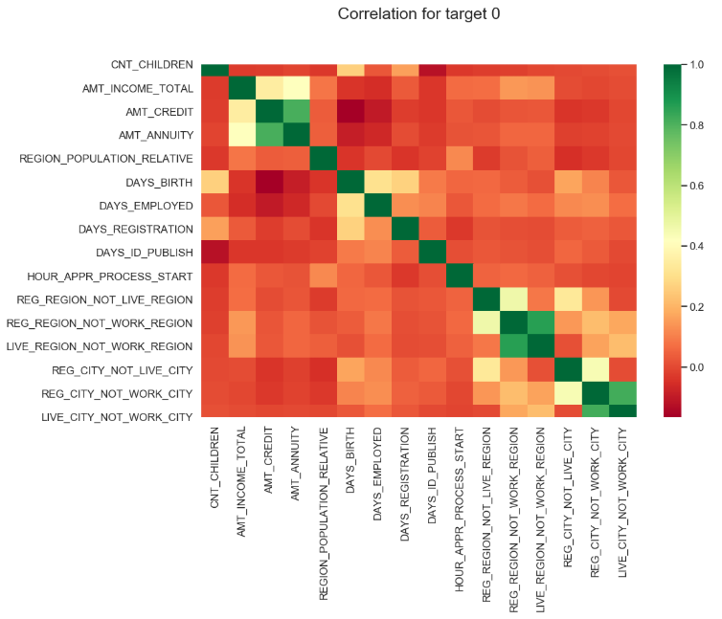

Slide 12
Points to be concluded from the graph presented before.
Credit amount is inversely proportional to the date of birth, which means Credit amount is higher for low age and vice-versa.
Credit amount is inversely proportional to the number of children client have, means Credit amount is higher for less children count client have and vice-versa.
Income amount is inversely proportional to the number of children client have, means more income for less children client have and vice-versa.
less children client have in densely populated area.
Credit amount is higher to densely populated area.
The income is also higher in densely populated area.

Slide 13
Correlation For target 1

Slide 14
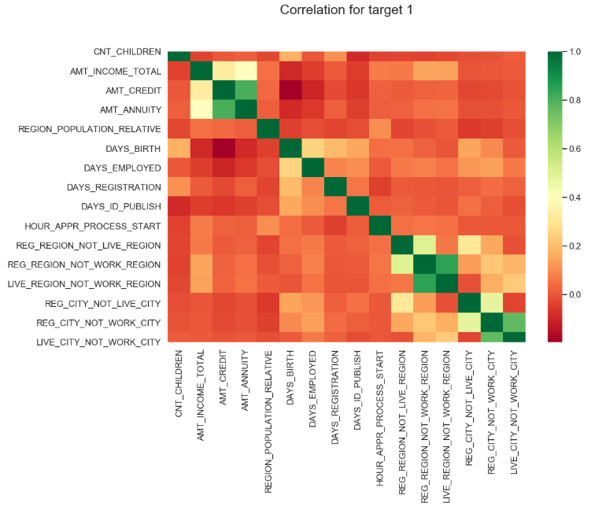

Slide 15
This heat map for Target 1 is also having quite a same observation just like Target 0. But for few points are different. They are listed below.
The client's permanent address does not match contact address are having less children and vice-versa
The client's permanent address does not match work address are having less children and vice-versa

Slide 16
Categorical Univariate analysis for variables target 0 And Target 1

Slide 17

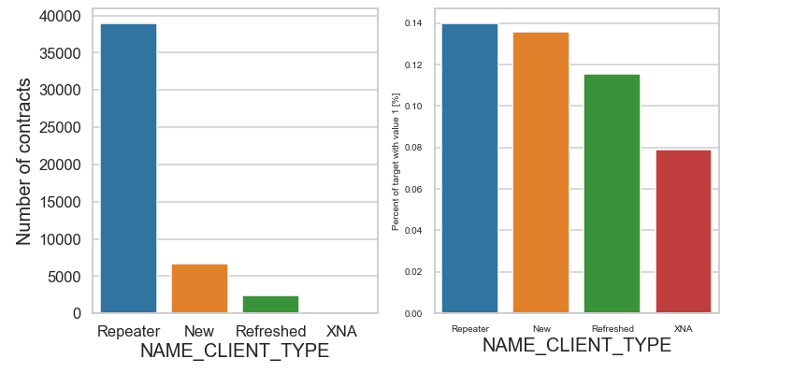
Few points can be concluded from the graph.
We can see that repeated customers are also not repaying the loans

Slide 18
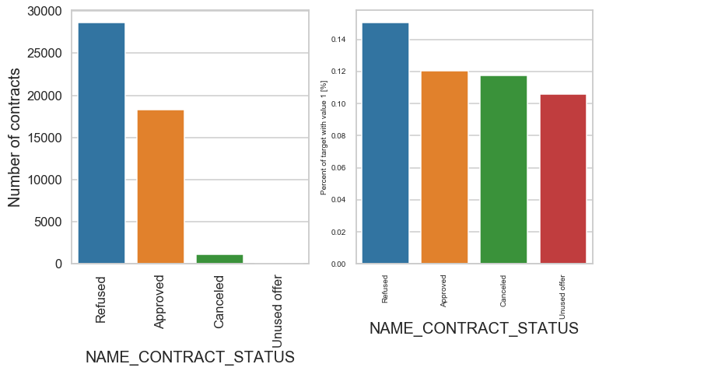
Few points can be concluded from the graph.
As it has to be , the percentage of refused is more for the category 1 but still the people who didn't pay for after the approval is also more than 60%

Slide 19
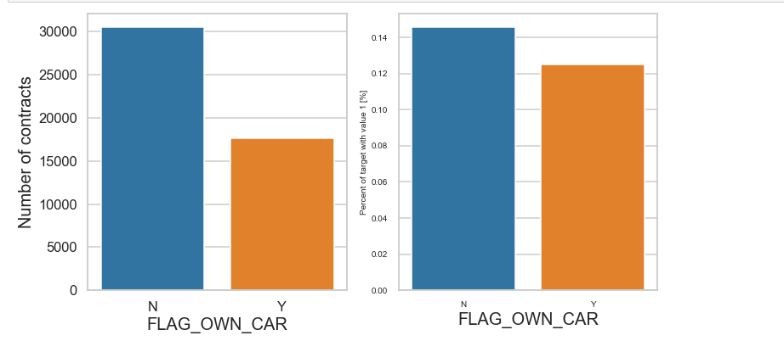
Few points can be concluded from the graph.
The clients that owns a car are almost a half of the ones that doesn't own one. The clients that owns a car are less likely to not repay a car that the ones that own. Both categories have not-repayment rates around 8%.

Slide 20
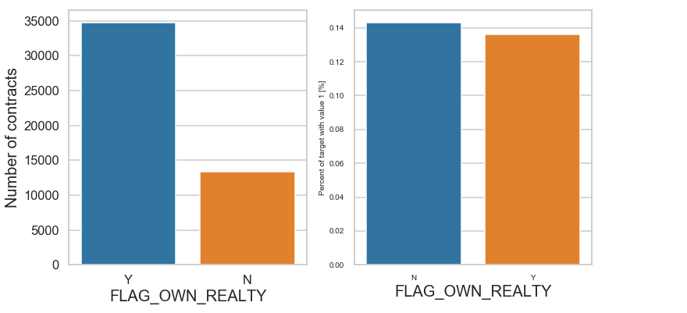
Few points can be concluded from the graph.
The clients that owns real estate are more than double of the ones that doesn't own.
Both categories (owning real estate or not owning) have non-repayment rates near to 8%

Slide 21
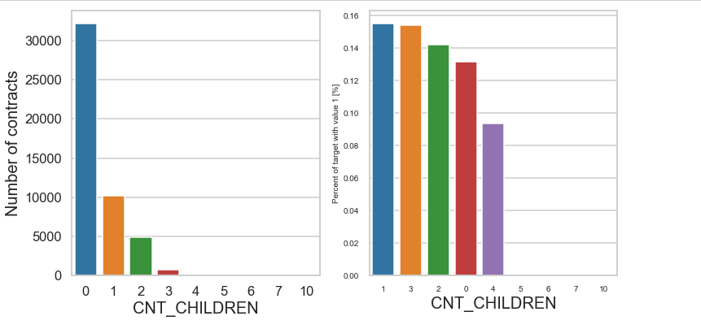
Few points can be concluded from the graph.
We can see that irrespective of 1,2,3,or 5 children the % of non payment is close but there is a difference for people with 6 and 4 kids

Slide 22
Bivariate analysis for type 0

Slide 23
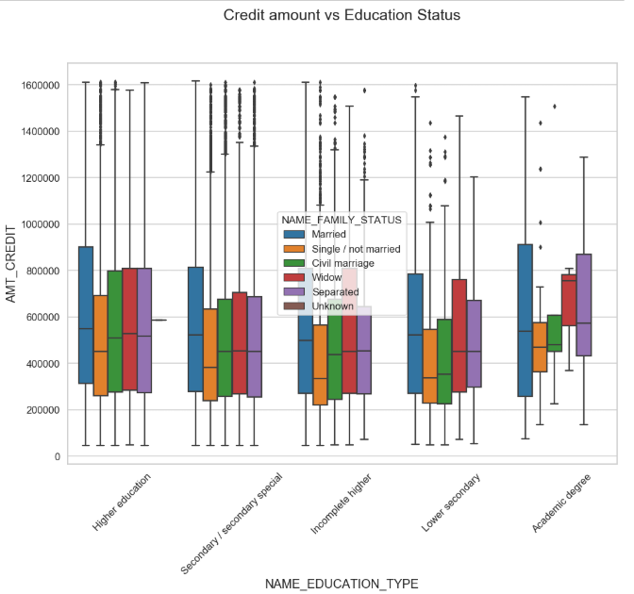
Credit amount vs Education Status
Few points can be concluded from the graph.
Family status of 'civil marriage', 'marriage' and 'separated' of Academic degree education are having higher number of credits than others.
Higher education of family status of 'marriage', 'single' and 'civil marriage' are having more outliers.
Civil marriage for Academic degree is having most of the credits in the third quartile.

Slide 24
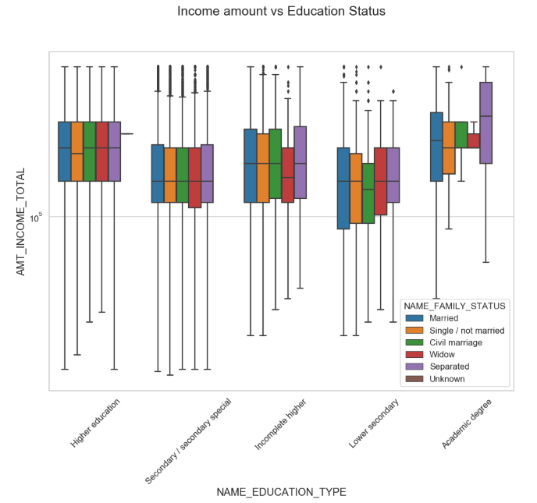
Income amount vs Education Status
Few points can be concluded from the graph.
For Education type 'Higher education' the income amount mean is mostly equal with family status. It does contain many outliers.
Less outlier are having for Academic degree but they are having the income amount is little higher that Higher education.
Lower secondary of civil marriage family status are have less income amount than others.

Slide 25
Bivariate analysis for type 1

Slide 26
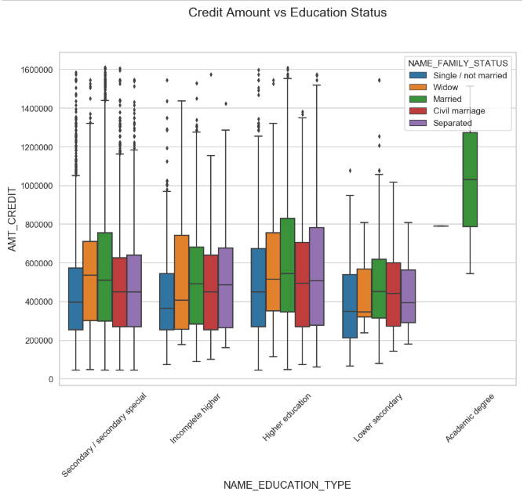
Credit amount vs Education Status
Few points can be concluded from the graph.
Quite similar from Target 0, we can say that Family status of 'civil marriage', 'marriage' and 'separated' of Academic degree education are having higher number of credits than others.
Most of the outliers are from Education type 'Higher education' and 'Secondary’.
Civil marriage for Academic degree is having most of the credits in the third quartile.

Slide 27
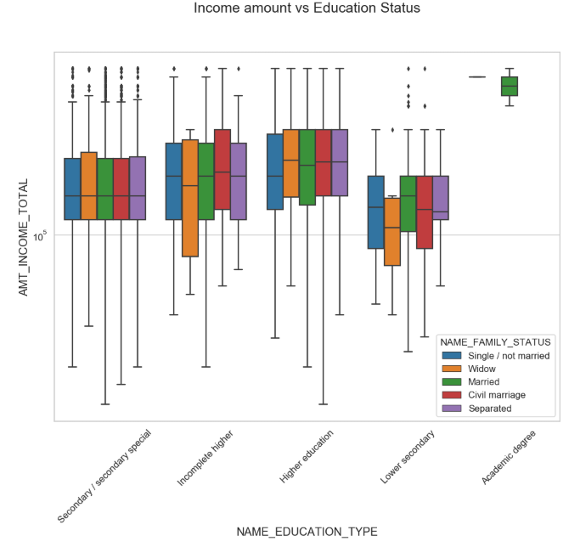
Income amount vs Education Status
Few points can be concluded from the graph.
Have some similarity with Target0, From above boxplot for Education type 'Higher education' the income amount is mostly equal with family status.
Less outlier are having for Academic degree but there income amount is little higher that Higher education.
Lower secondary are have less income amount than others.

Slide 28
Univariate analysis after merging previous data

Slide 29
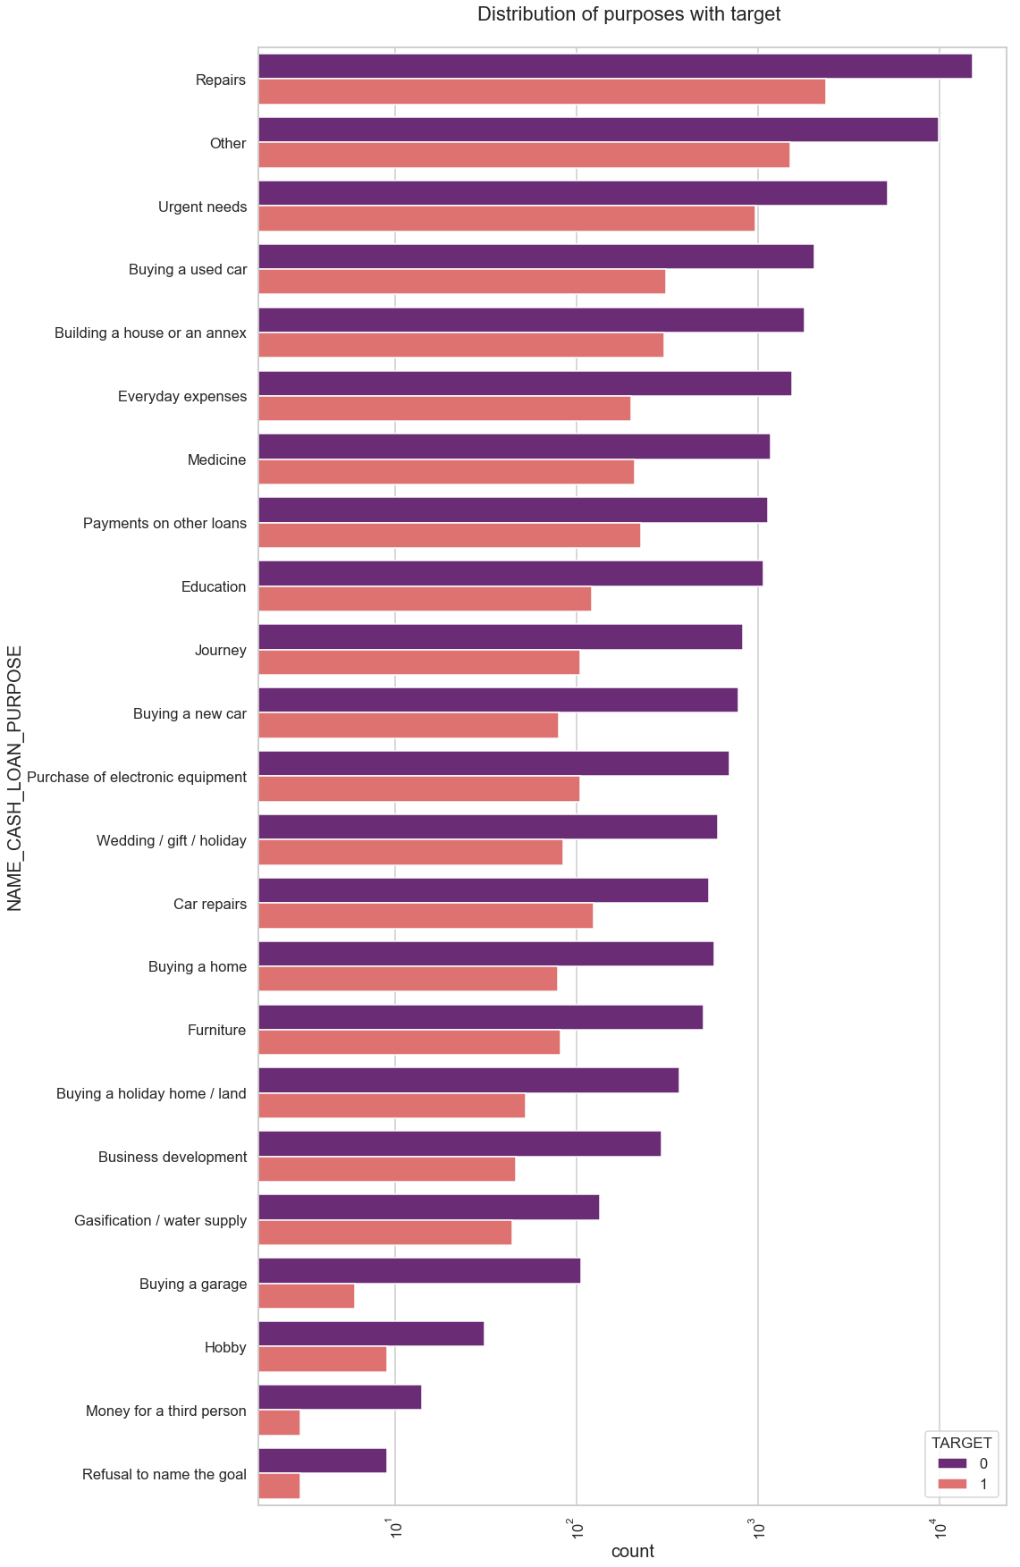
Distribution of purposes with target
Few points can be concluded from the graph.
Loan purposes with 'Repairs' are facing more difficulties in payment on time.
There are few places where loan payment is significant higher than facing difficulties. They are 'Buying a garage', 'Business development', 'Buying land’, 'Buying a new car' and 'Education' Hence we can focus on these purposes for which the client is having for minimal payment difficulties.

Slide 30
Performing bivariate analysis

Slide 31
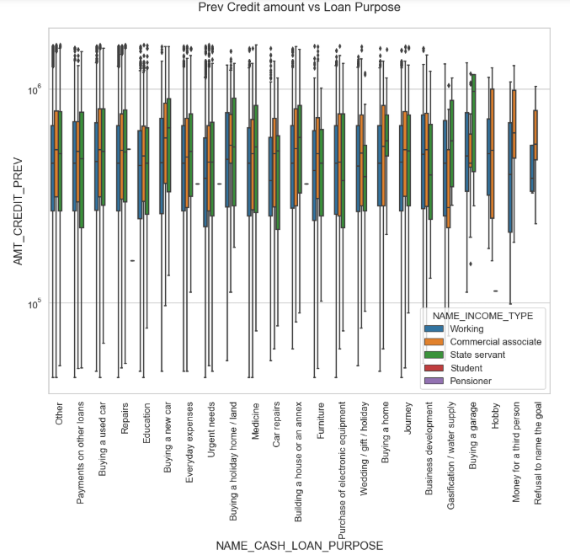

Slide 32
Previous Credit amount vs Loan Purpose
From the previous graph we can conclude the below points:
The credit amount of Loan purposes like 'Buying a home’, ’Buying a land’, 'Buying a new car' and ‘Building a house' is higher.
Income type of state servants have a significant amount of credit applied
Money for third person or a Hobby is having less credits applied for.

Slide 33
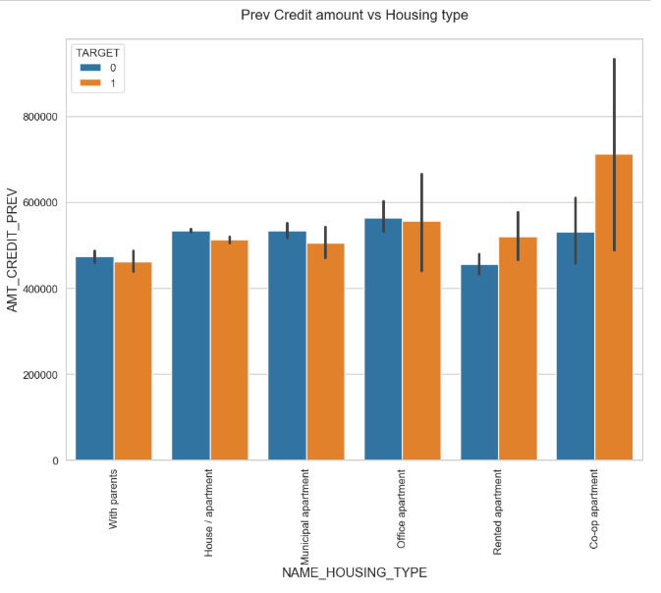
Prev Credit amount vs Housing type
Few points can be concluded from the graph.
Here for Housing type, office apartment is having higher credit of target 0 and co-op apartment is having higher credit of target 1.
So, we can conclude that bank should avoid giving loans to the housing type of co-op apartment as they are having difficulties in payment.
Bank can focus mostly on housing type with parents or House\apartment or municipal apartment for successful payments.

Slide 34
conclusion
Banks should focus more on contract type ‘Student’ ,’pensioner’ and ‘Businessman’ with housing ‘type other than ‘Co-op apartment’ for successful payments.
Banks should focus less on income type ‘Working’ as they are having most number of unsuccessful payments.
Also with loan purpose ‘Repair’ is having higher number of unsuccessful payments on time.
Get as much as clients from housing type ‘With parents’ as they are having least number of unsuccessful payments.

Slide 35
Thank you

